Slide 1

Airbnb Hotel Booking Analysis-
Matta Naga Jyothi Krishna Sai Tarun
APPLY_175647653068b1b47224d88

Slide 2

PROBLEM STATEMENT
The spread of Airbnb listings will require additional insight into the dynamics of booking to streamline the platform to the benefit of everyone. The main issue is that there are no clear, data-driven understandings of what are the major factors that could be considered to make a successful booking, a pricing strategy, and guests satisfaction.
In the absence of this knowledge, the hosts will fail to maximize their income and Airbnb will not be able to effectively improve the user experience. Thus, the purpose of the project is to identify patterns, trends, and actionable information about booking data to support the decision-making process of the hosts and to enhance the overall experience of the guest.

Slide 3
Project Description The project aims at training a machine learning model to estimate the price of Airbnb listings. The idea of pricing an Airbnb property is essential to both the host and the traveler: the former would like to optimize their occupancy and revenues, whereas the latter would prefer reasonable and competitive prices. The project is based on historical Airbnb data, which learns the relationship among listing features (including number of bedrooms, bathrooms, and guest ratings) and the price charged to be able to predict prices of new or hypothetical listings and assist property owners make an informed pricing choice.

Slide 4

WHO ARE THE END USERS?
Airbnb Hosts:-
To optimize pricing of their listings based on property features and guest reviews.
Travelers:-
To evaluate whether a listing is overpriced or reasonably priced.
Airbnb Platform Analysts:-
To improve automated pricing suggestions and increase platform trust.
Researchers/Students:-
To study the impact of property features and reviews on rental pricing.

Slide 5

Technology Used
Python - General-purpose programming language.
Pandas - Data cleaning and preprocessing NumPy - Data cleaning and preprocessing
Scikit-learn - Machine learning (train model, regression, test)
Matplotlib/Seaborn - Feature importance and data visualization.
Google Colab - Internet server to run the project.
File processing libraries - openpyxl (Excel) and in-built CSV processing.

Slide 6
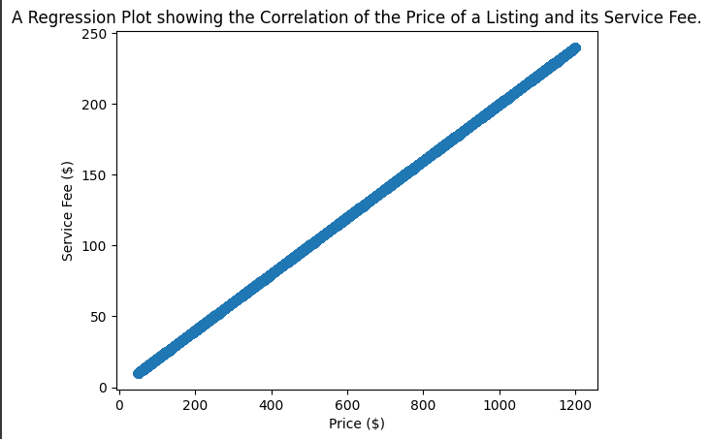
RESULTS1
Demo Link

Slide 7
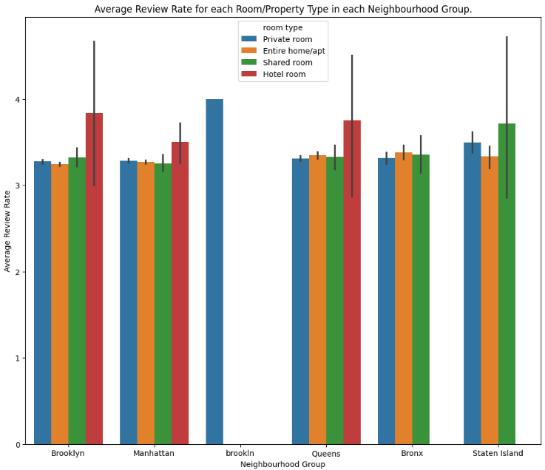
RESULTS2
Demo Link

Slide 8
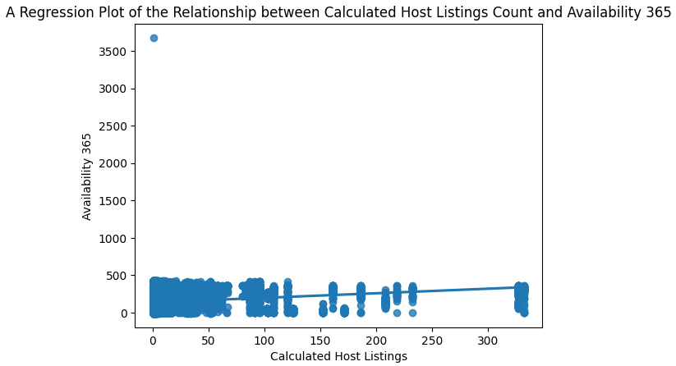
RESULTS3
Demo Link

Slide 9
GitHub repository
[Add the working url of your github repository ]
Create github repository with format VOIS_AICTE_Oct2025_YourName
Demo Link

Slide 10
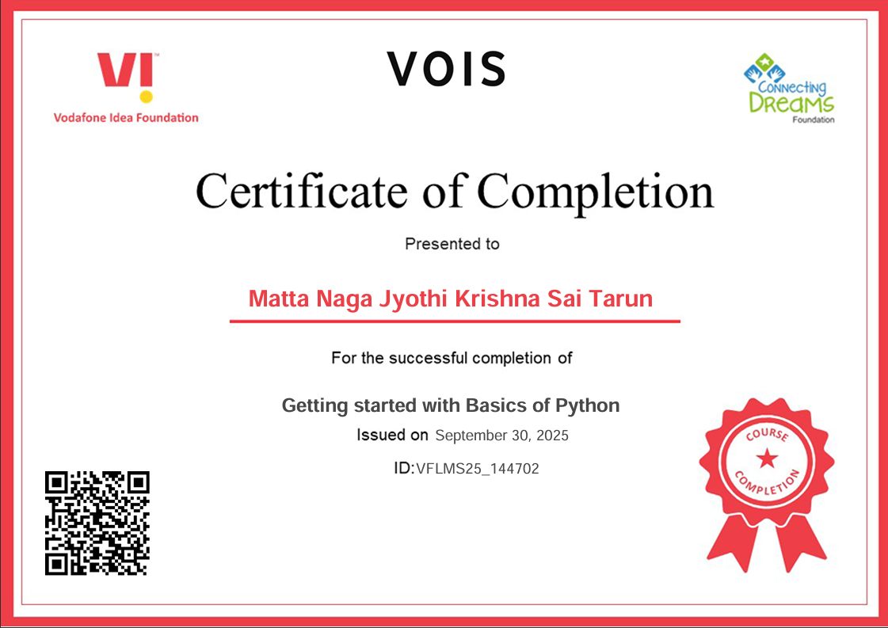
Getting started with Basics of Python Certificate
[Paste your Certificate Here]

Slide 11
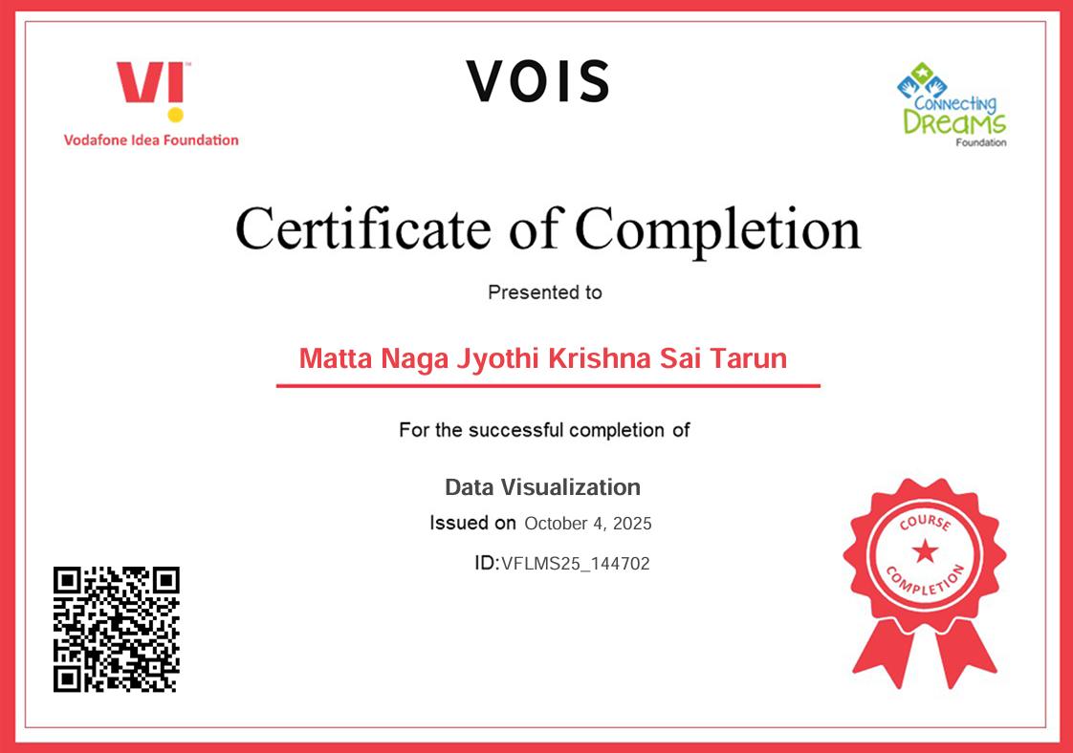
Data Visualization Certificate
[Paste your Certificate Here]

Slide 12
Thank you
.
.

